Slide 1
Deadlocks and IPC
CS 0449
Jarrett Billingsley

Slide 2
Class announcements
last real lecture aaaaaaa
uhhhhhhhhh
watch your email to know if we’re gonna have lecture on the Tuesday after Thanksgiving
  cause.... idk if we’ll need it

Slide 3
Deadlocks, continued

Slide 4
Multiple mutexes (animated)
let’s say we have some roads that look like this.
these two parts of the road are shared resources: only one car should be in them at any time to avoid a collision.
cars going straight or turning right only need one of the boxes.
M2
but a car turning left needs both.
M1
let’s name the bottom right box M1 and the top left box M2, and think about the order in which the car needs them.
Notes:
- I mean technically EVERY part of the road is a shared resource but we’re assuming people drive correctly (lol poor assumption)

Slide 5
Is it still “gridlock” if it doesn’t happen on a grid?
of course, if you get unlucky, this breaks down.
let’s look at 23_deadlock.c
the threads lock the mutexes in the same orders as the cars pass through the boxes, and just like in the real world, the threads deadlock.
T2
M2
T1
M1
but in the real world, how could the driver(s) solve this problem?
Notes:
[diagram: two cars in opposing directions both trying to turn left, but each is blocking the other from doing so.]

Slide 6



Conditions for a deadlock
there are four conditions needed for deadlocks to occur, and if any of these conditions is avoided/broken, deadlocks are impossible.
circular waiting: each actor is waiting for a resource that the other one has already acquired.
mutual exclusion: the resources can only be used by one actor at a time.
hold-and-wait: each actor refuses to give up what they already have; then tries to get another resource.
no stealing: no one else can forcefully take away a resource that an actor has already acquired.
Notes:
- the “hold-and-wait” condition is how the car in the real-world example on the last slide can break the deadlock – by giving up their spot on the road and driving away, another car can now use that part of the road.

Slide 7
An ounce of prevention
sadly, deadlocks cannot be detected in the general case
  because you’d have to solve the halting problem to do it
but you can avoid them by following some good practices:
  nest critical sections.
    unlock mutexes in the opposite order that you locked them.
  enter critical sections in the same order on all threads.
    23_nested.c shows both of the above in action.
  redesign your program to avoid the possibility of deadlock.
    e.g. use a different synchronization primitive
    or make the critical section bigger/use fewer mutexes
  use nonblocking locks and waits if necessary.
    23_trylock.c shows the use of pthread_mutex_trylock
      not a great solution in all cases but sometimes necessary
    pthread_cond_timedwait exists for condvars too

Slide 8
Multiprocess programs

Slide 9
Nasty tabs
let’s say your browser runs each tab in its own thread. you visit your bank in one tab, and another tab is running malware.
Process
Tab Thread 1
$$$
bank.com
virus.com
Hi, Jeff Bezos!
Your balance is:
$244,000,000,000
Tab Thread 2
>:)
Notes:
- a little over a year ago, Jeff Bezos was “only” worth 169 billion dollars. wow, he must have done a LOT of work in that time to earn 75 billion dollars! what a hard-working guy! who totally deserves to have that much money and power! yup! good system!
[diagram: two tabs open in a browser. one is a bank account. the other is some malicious site. if we make each tab a thread, malicious threads can easily mess with other threads' memory, because they are in the same process.]

Slide 10
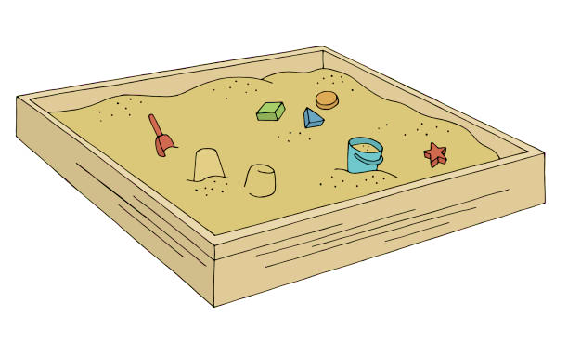
Stay in the sandbox
sandboxing is a security technique where a process’s permissions are intentionally limited to prevent it from doing Nasty Things.
maybe it can’t access the internet, can’t open any files, and can only use up to 5% of the CPU.
this is a very useful technique for running code that you downloaded over the internet, like exists on every webpage now
>:(
the downside is, these permissions are almost always specified on a per-process basis, NOT per-thread.
Notes:
his ass is NOT having fun

Slide 11
But if you can do that…
it provides a very strong security boundary enforced by the OS and the hardware (due to virtual memory)!
Tab Process 1
$$$
bank.com
virus.com
Hi, Jeff Bezos!
Your balance is:
$203,000,000,000
Tab Process 2
<:(
Notes:
[diagram: now each tab gets its own process, which means tabs cannot interfere with one another.]

Slide 12
Kaboom
another potential issue with multithreaded programs is stability.
all these threads share the same memory space with each other. so if one thread goes nuts, starts writing garbage into memory, does UB…
Process
T1
T2
T3
T4
T5
T6
now you have no idea if the other threads are still okay, or if they’re gonna start crashing too!
T7
T8
T9
in a multiprocess program, if one process crashes, it won’t take down any others.

Slide 13
But how??
we know that programs like this exist. it’s how browsers work.
but isn’t the whole point of processes to isolate them from all other processes so that they can’t know of each others’ existence?
  well yes, by default, but…
we can give processes limited, safe communication channels so that they can work together in a controlled fashion.
these techniques are called…

Slide 14
Inter-process Communication (IPC)

Slide 15

IPC using files
the file system is state shared by all processes.
so, the OS ensures synchronized access to files.
for two processes to communicate this way, they both open the same file at the same time.
now, whatever one process writes…
  the other one can read.
the upside to this method is that every single OS supports it. it works everywhere.
but the downside is poor performance.
  one reason is that persistent storage is much, much slower than the CPU and memory.
  the other… well what boundary are we crossing multiple times here?
User Space
P1
P2
Kernel Space

Slide 16

IPC using pipes
why do we need to get the persistent storage involved at all? “everything” is a file, after all.
a pipe is a kind of virtual file provided by the OS.
one process can write to it…
  and another can read from it.
this is exactly how ps aux | less works.
this is pretty well-supported on most OSes, but…
  you have to use different APIs on each OS
  their behaviors can be subtly different on each
and though the persistent storage is no longer involved, we’re still doing lots of context switches.
User Space
P1
P2
Kernel Space

Slide 17
Clogged pipes
pipes also give us an example of how two processes can deadlock.
let’s say you’re writing an autograder for an interactive program 🙃
the autograder sends some text to the program’s stdin pipe, then waits for some output on the stdout pipe.
💤
💤
grader
program
mercury
you’d weigh 38.0
the program prints something to stdout, but stdio buffering keeps it in a buffer. then it waits for some more input.
now they’re both asleep and will never wake up.
it’s the buffering that causes issues. but you might not be able to turn it off!
Notes:
the way I had to disable it on the lab 2 autograder was to insert a shim main() function that turned off stdio buffering before calling your main().
but generally speaking, you can’t do this. I was able to do that because I had your program’s source code. if you have some random executable, you can’t. stdio buffering is something inside the executable; it’s not an OS thing and the OS doesn’t know about it.
you might be able to do something with LD_PRELOAD on Linux but hoo boy we’re getting real spicy now
“well-behaved” programs on POSIX systems will detect when stdin/stdout/stderr are pipes and will disable stdio buffering if so, but it’s something that has to be explicitly programmed in.

Slide 18
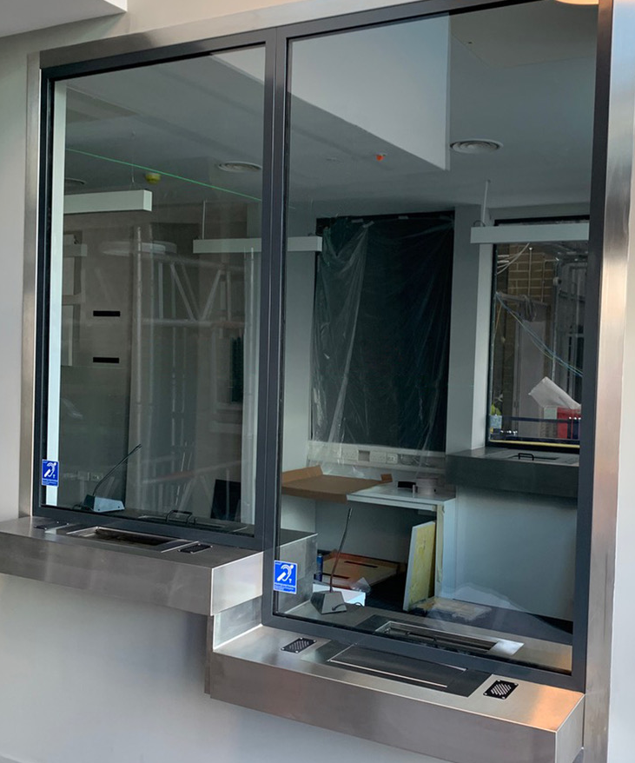
We have to go faster
you know these security counter things?
you can exchange very small items (like money and tickets) through the small slot at the bottom.
this is a controlled way of sending things back and forth past the barrier.
what if we could set something up like this for our processes?
maybe some way of sharing a small piece of memory between processes…
I wonder if virtual memory could help us…

Slide 19
IPC using shared memory
virtual memory maps processes’ virtual addresses to physical ones.
what if you mapped the same physical page to two processes?
P1’s Page Table
Physical Memory
P2’s Page Table
VA | PA
... | ...
C4000 | 43000
C3000 | 06000
C1000 | 07000
... | ...
PA | value
... | ...
06002 | 7C
06001 | 01
06000 | 38
... | ...
VA | PA
... | ...
8E000 | 90000
8D000 | 06000
8B000 | FC000
... | ...
P1
P2
now both processes can access the same piece of memory, but only limited to this single page (e.g. 4 KiB).
this has to be set up by the OS, but once it is, there’s no more context switching needed to communicate!

Slide 20
Shared memory
let’s look at 23_shmem.c
we can even run multiple consumers, but with the way it’s written that opens us up to race conditions…
  because two (or more) consumers could “see” that there is a message to print at the same time!
you could, of course, just put a mutex in the shared memory!
  there are some extra considerations when doing so, but for the most part, it kinda just works the way you expect.
so if shared memory is so great, what are the downsides?
  it works differently on every OS, and not every OS even has it
  it requires hardware support in the CPU to maintain cache coherence
Notes:
- this page https://linux.die.net/man/3/pthread_mutexattr_init has a section called “Process Shared Memory and Synchronization” which explains how to set up a mutex (well, a mutex and a semaphore) that is shared between two processes in shared memory. you apparently have to set a special attribute on the mutex to make it work right.

Slide 21
IPC using sockets
a socket is similar to a pipe, except it’s a part of an OS’s networking capabilities.
  it’s not an actual physical socket where something plugs in…
sockets are usually used to communicate between multiple computers.
but because they’re an OS abstraction, nothing is stopping you from connecting to another socket on the same computer!
they also give you the option of communicating with a process that is running on another computer, and your program doesn’t really know the difference.
  and that’s exactly what a browser does!
User Space
P1
P2
127.0.0.1:3456
example.com:3456

Slide 22
IPC summary
these are the most common kinds of IPC, but there are others. most of them kind of boil down to one of these with extra steps, tho.
Technique | Context Switches? | Supported… | Notes
Files | yes, plus storage access | every OS, for decades | synchronization handled for you by the OS
Pipes | yes | every OS, with caveats | have to be careful about buffering
Shared Memory | no | on modern OSes and CPUs | up to you to do synchronization
Sockets | yes or no, depends | on OSes with networking | can connect to other computers too
Notes:
the “yes or no, depends” for sockets is because sockets can be abstracted by the OS in such a way that if it sees two processes connecting to each other, it can use shared memory to accelerate the socket.
also the “on OSes with networking” definitely applies to anything you’re likely to encounter on a personal computer, phone, tablet etc. but there are definitely OSes without networking running on a lot of appliances, in control systems, on embedded devices, and so on. networking is actually a pretty big and complex component, so some systems just leave it out to save space.

